Slide 1
Programming II
(C Programming Language)
Decision Making in C
(Part I)
Lecture 5, Monday February 08, 2021
Dr. Ayman ALJARBOUH

Slide 2
Outline
Decision Making
if Statement
If…else Statement
If…else if…else Statement
Nested if Statement

Slide 3
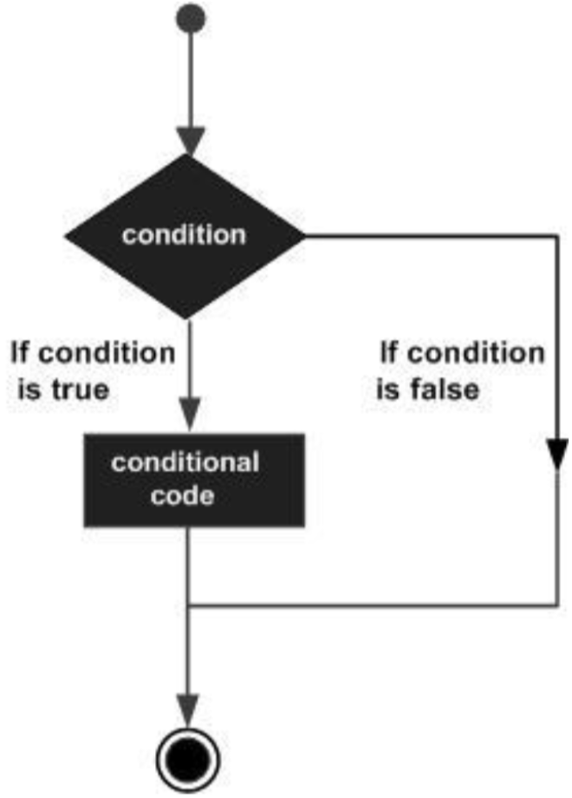
Decision Making in C
Decision making requires one or more conditions to be evaluated or tested by the program
It also requires a statement or statements to be executed if the condition is determined to be true
Optionally, other statements could be executed if the condition is determined to be false
Decision making structure

Slide 4
Outline
Decision Making
if Statement
If…else Statement
If…else if…else Statement
Nested if Statement

Slide 5
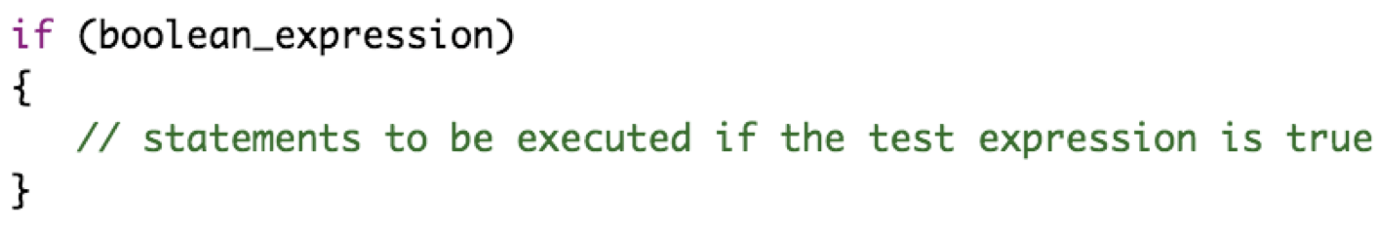
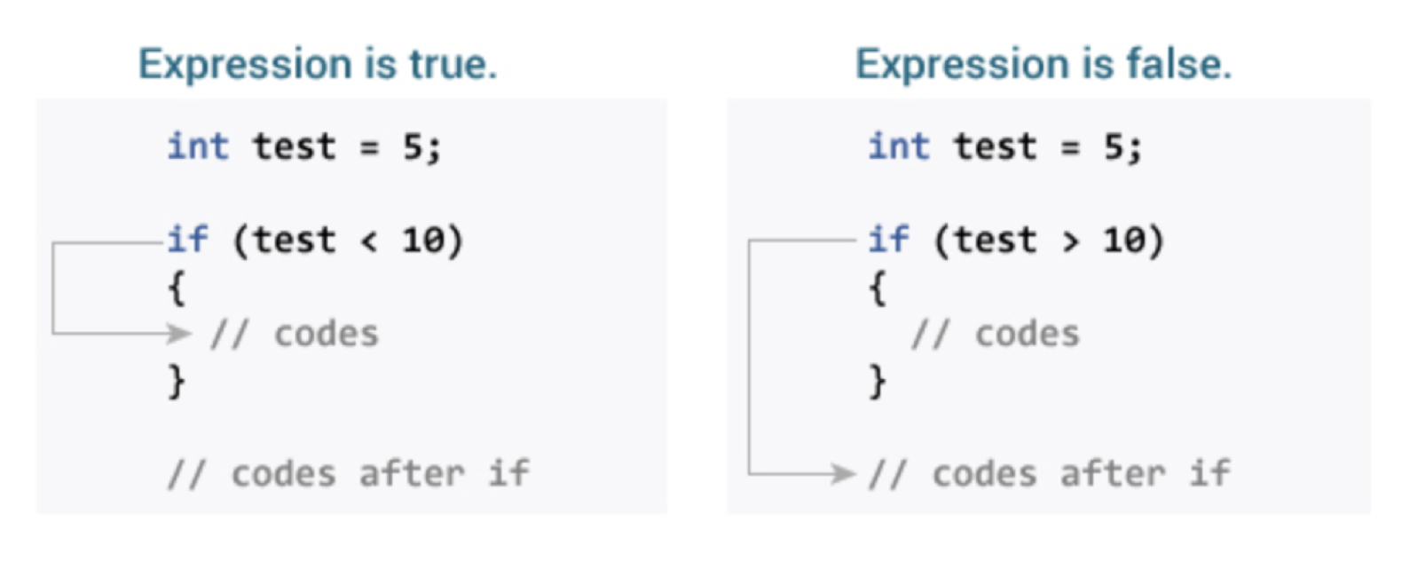
if Statement in C
An if statement in Python consists of a Boolean expression followed by one or more statements. The syntax is:
If the test expression is evaluated to true, statements inside the body of if are executed

Slide 6
if Statement in C
An if statement in Python consists of a Boolean expression followed by one or more statements. The syntax is:
If the test expression is evaluated to false, statements inside the body of if are not executed, then the first set of code after the end of the if statement (after the closing curly brace) will be executed

Slide 7
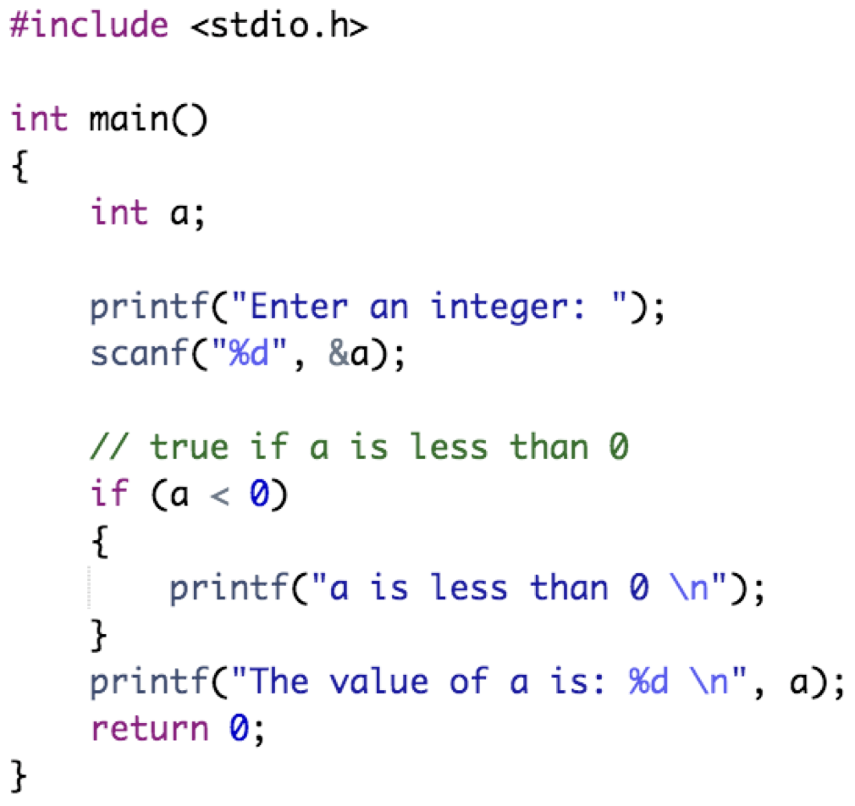
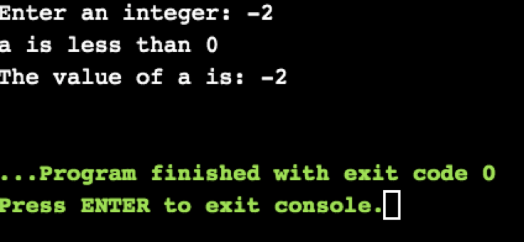
if Statement in C
Output:
Example:

Slide 8
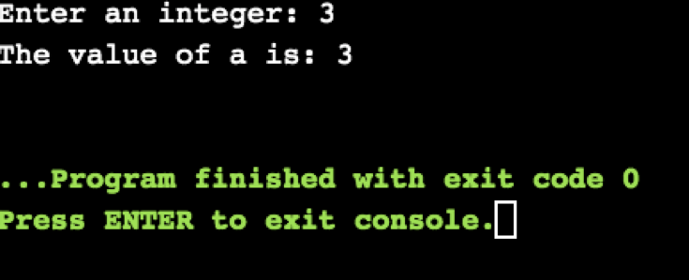
if Statement in C
Output:
Example:

Slide 9
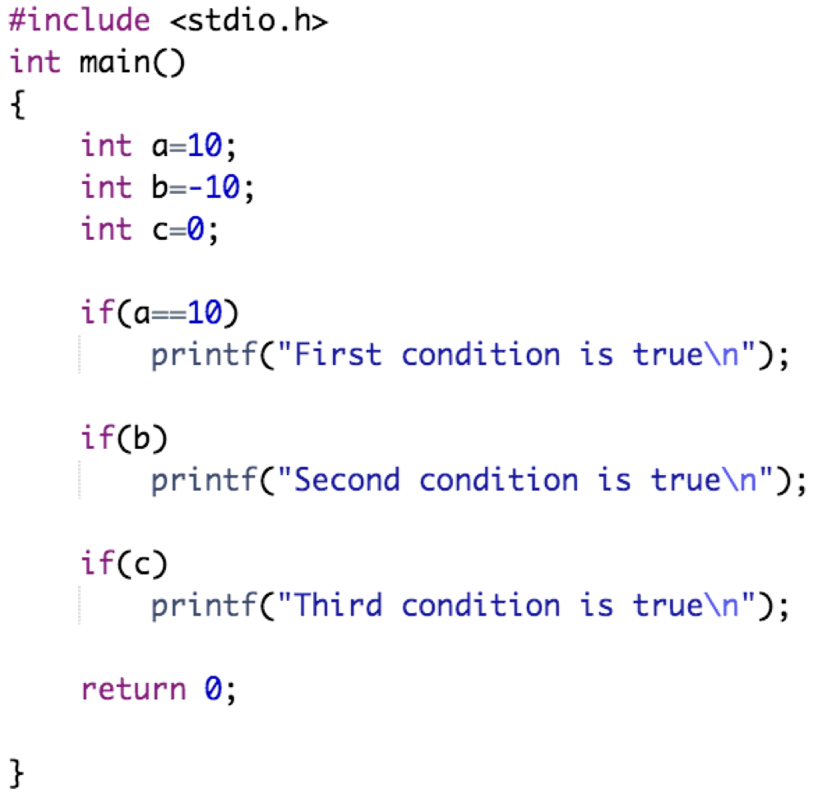
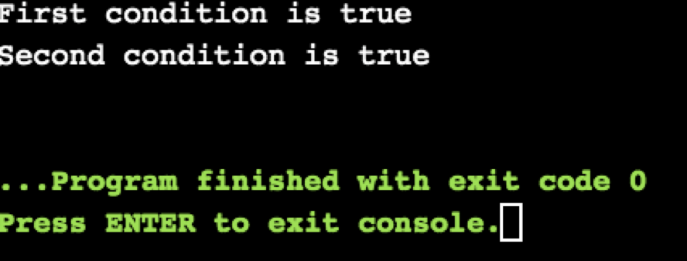
if Statement in C
C programming language assumes any non-zero, and non-null values as true and if it is either zero or null then it is assumed as false value
Example:
Output:

Slide 10
Outline
Decision Making
if Statement
If…else Statement
If…else if…else Statement
Nested if Statement

Slide 11
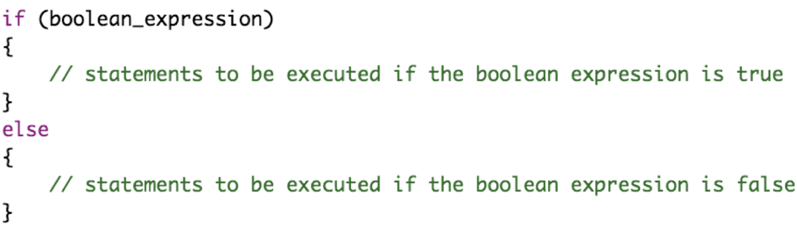
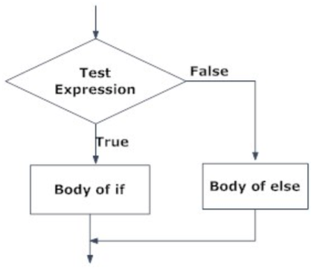
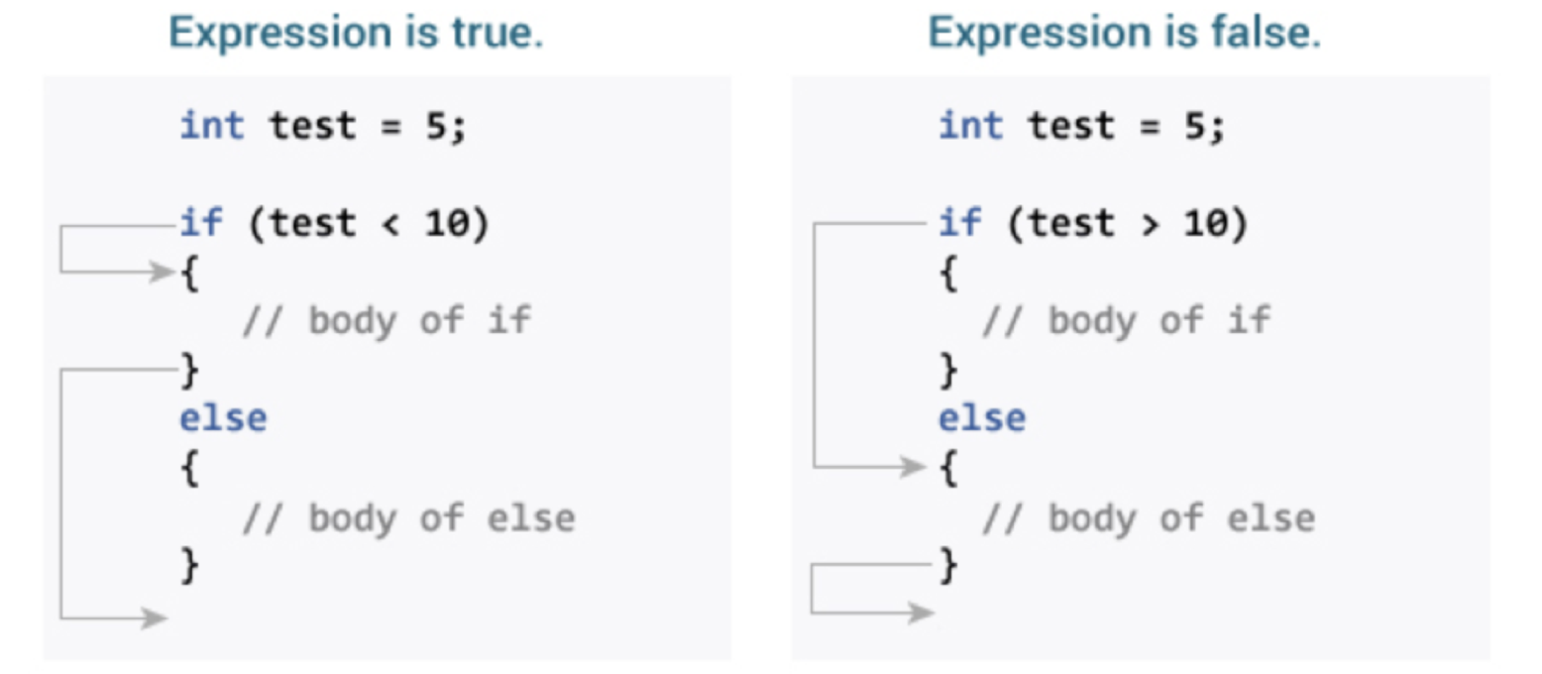
if…else Statement in C
An if statement can also be followed by an else statement which executes when the Boolean expression is false. The syntax is:
If the boolean expression is true:
Statements inside if are executed and statements inside else are skipped

Slide 12
if…else Statement in C
An if statement can also be followed by an else statement which executes when the Boolean expression is false. The syntax is:
If the boolean expression is false:
Statements inside else are executed and statements inside if are skipped

Slide 13
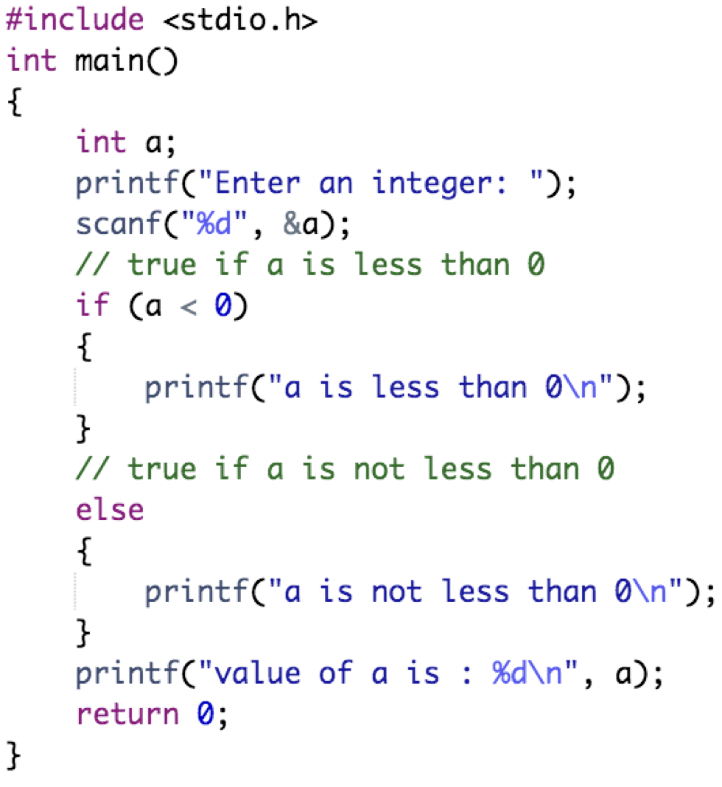
if…else Statement in C
Output:
Example:

Slide 14
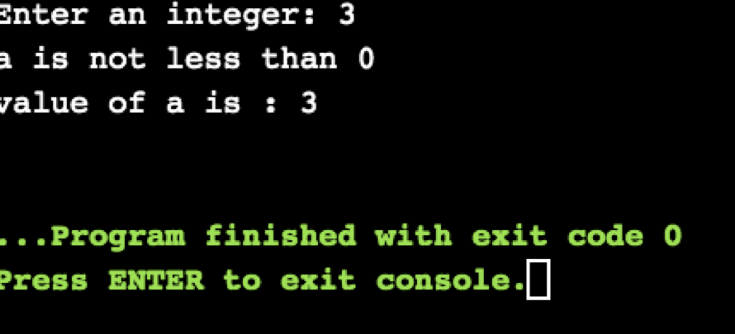
if…else Statement in C
Output:
Example:

Slide 15
Outline
Decision Making
if Statement
If…else Statement
If…else if…else Statement
Nested if Statement

Slide 16
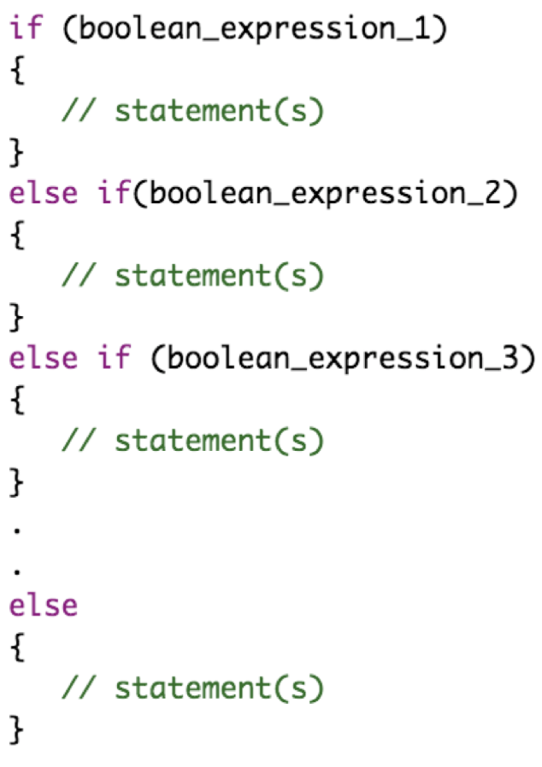
if…else if…else Statement in C
The if...else if...else is used when you need to choose from several possible alternatives. The else statement must always come last,
If a boolean expression is evaluated to true, its code block will be executed, if it is false, then the next boolean expression will be checked. If any of the conditions is not true, then else code block will be executed

Slide 17
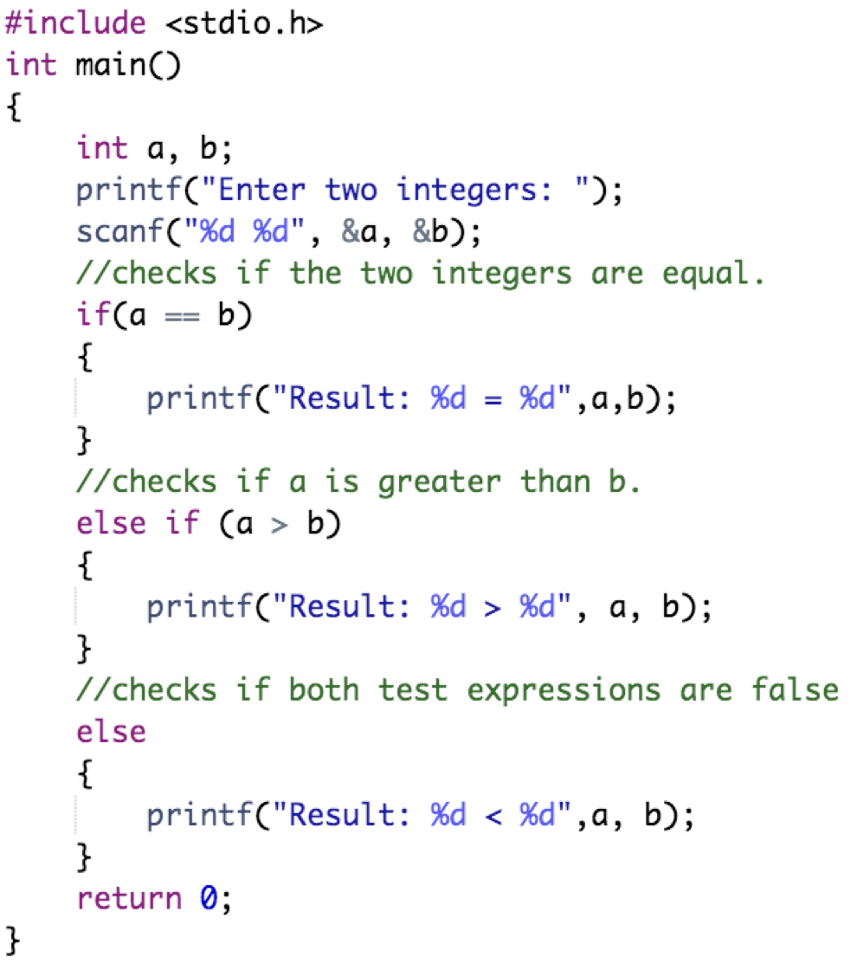
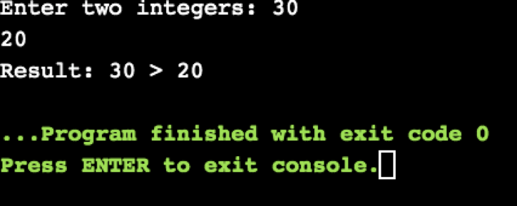
if…else if…else Statement in C
Output:
Example:

Slide 18
Outline
Decision Making
if Statement
If…else Statement
If…else if…else Statement
Nested if Statement

Slide 19
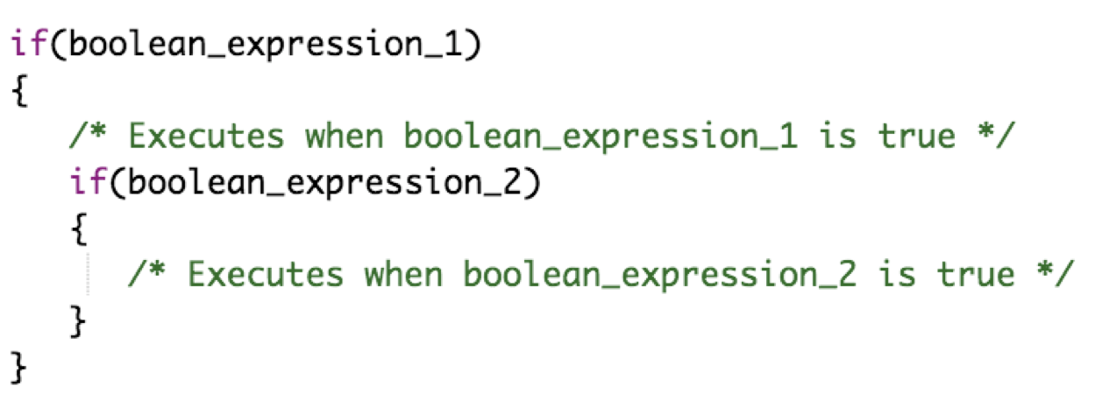
Nested if Statement in C
An if statement that contains another if statement either in its if block or else block is called a nested if statement
Syntax of simple nested if statement:

Slide 20
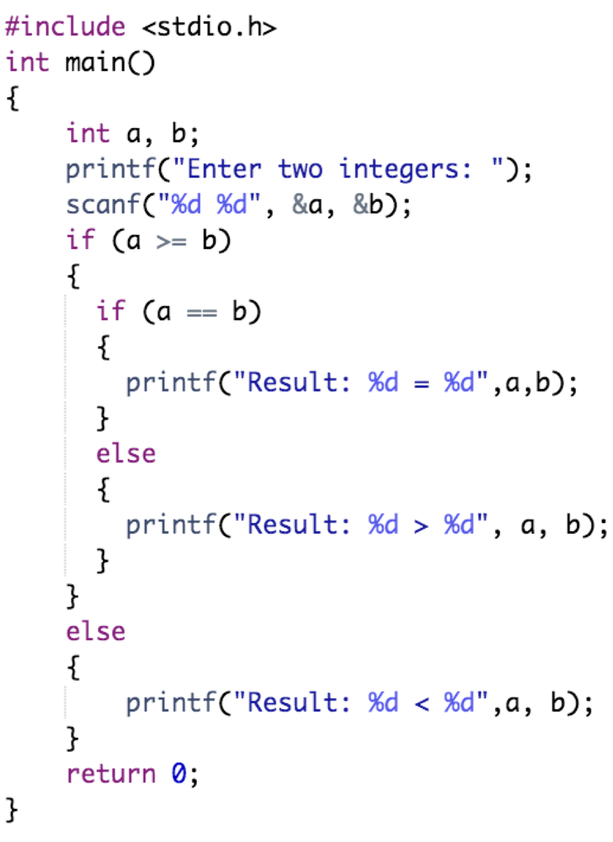
Nested if Statement in C
Output:
Example:

Slide 21

Practical Exercises
Write and Compile the following C programs:
Program 1:

Slide 22

Practical Exercises
Write and Compile the following C programs:
Program 2:

Slide 23
Practical Exercises
Write and Compile the following C programs:
Program 3:

Slide 24
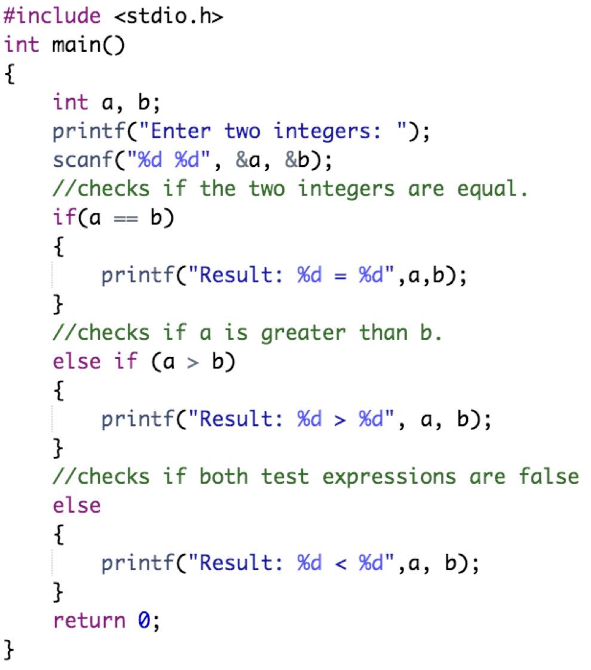
Practical Exercises
Write and Compile the following C programs:
Program 4:

Slide 25
Practical Exercises
Write and Compile the following C programs:
Program 5:

